Slide 1
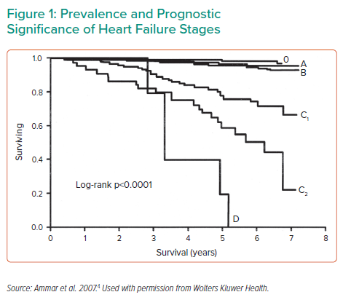
Yancy CW
Prevalence and Prognostic Significance of Heart Failure Stages
Citation: Interventional Cardiology Review 2022;17(Suppl 1):15–7.
https://doi.org/10.15420/icr.2022.17.S1

