Slide 1
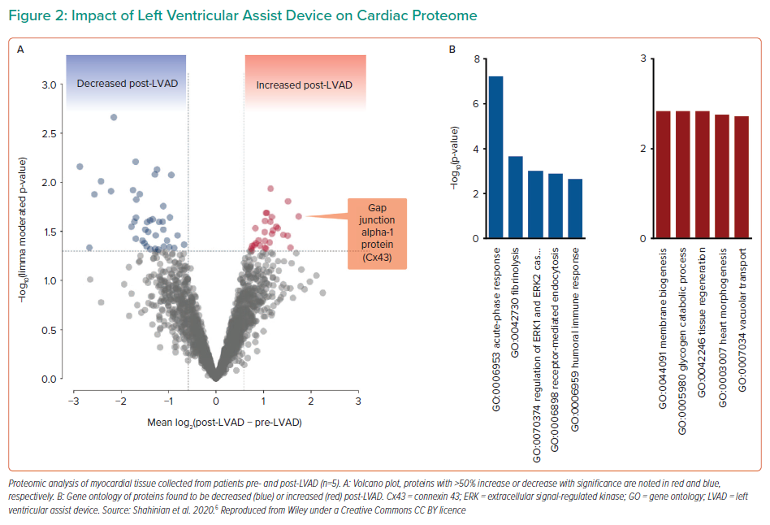
Yancy CW
Impact of Left Ventricular Assist Device on Cardiac Proteome
Citation: Interventional Cardiology Review 2022;17(Suppl 1):15–7.
https://doi.org/10.15420/icr.2022.17.S1

