Slide 1
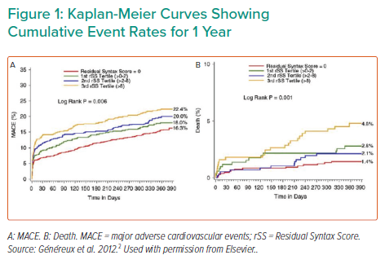
Schäfer A
Kaplan-Meier Curves Showing Cumulative Event Rates for 1 Year
Citation: Interventional Cardiology Review 2022;17(Suppl 1):18–9.
https://doi.org/10.15420/icr.2022.17.S1

