Slide 1
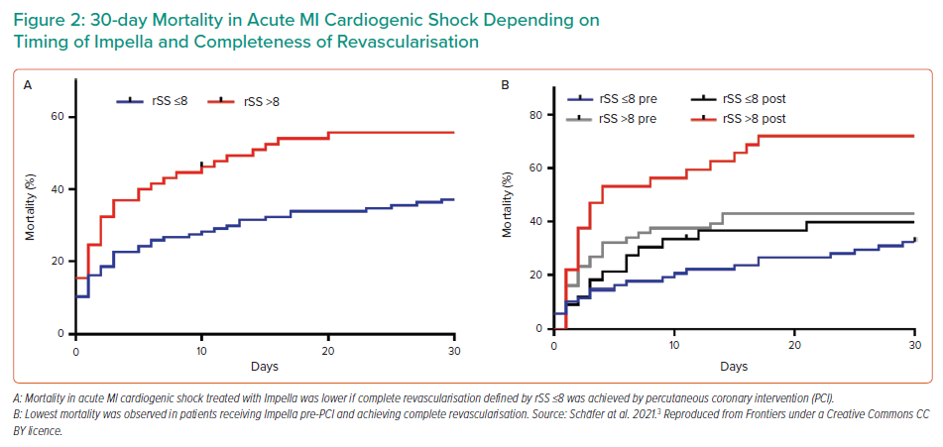
Schäfer A
30-day Mortality in Acute MI Cardiogenic Shock Depending on Timing of Impella and Completeness of Revascularisation
Citation: Interventional Cardiology Review 2022;17(Suppl 1):18–9.
https://doi.org/10.15420/icr.2022.17.S1

