Slide 1
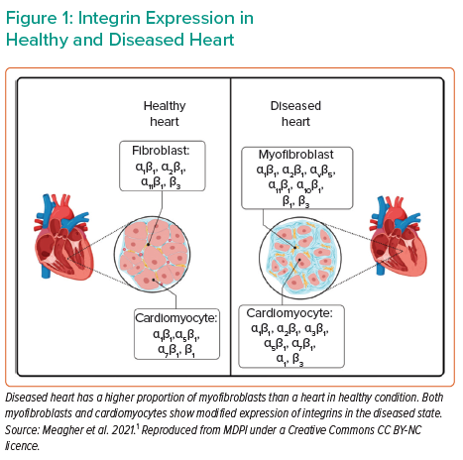
Tschöpe C
Integrin Expression in Healthy and Diseased Heart
Citation: Interventional Cardiology Review 2022;17(Suppl 1):20.
https://doi.org/10.15420/icr.2022.17.S1

