Slide 1
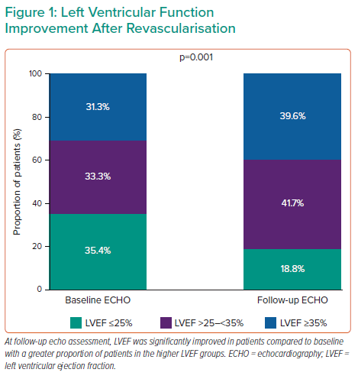
Romagnoli E
Left Ventricular Function Improvement After Revascularisation
Citation: Interventional Cardiology Review 2022;17(Suppl 1):21.
https://doi.org/10.15420/icr.2022.17.S1

