Slide 1
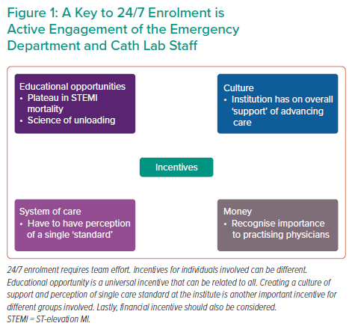
Faraz H
A Key to 24/7 Enrolment is Active Engagement of the Emergency Department and Cath Lab Staff
Citation: Interventional Cardiology Review 2022;17(Suppl 1):22.
https://doi.org/10.15420/icr.2022.17.S1

