Slide 1
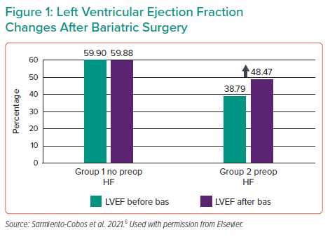
Brozzi N
Left Ventricular Ejection Fraction Changes After Bariatric Surgery
Citation: Interventional Cardiology Review 2022;17(Suppl 1):25.
https://doi.org/10.15420/icr.2022.17.S1

