Slide 1
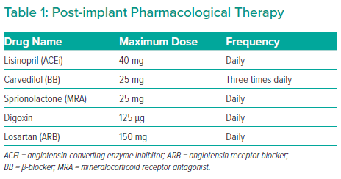
Birks E
Post-implant Pharmacological Therapy
Citation: Interventional Cardiology Review 2022;17(Suppl 1):27–8.
https://doi.org/10.15420/icr.2022.17.S1

