Slide 1
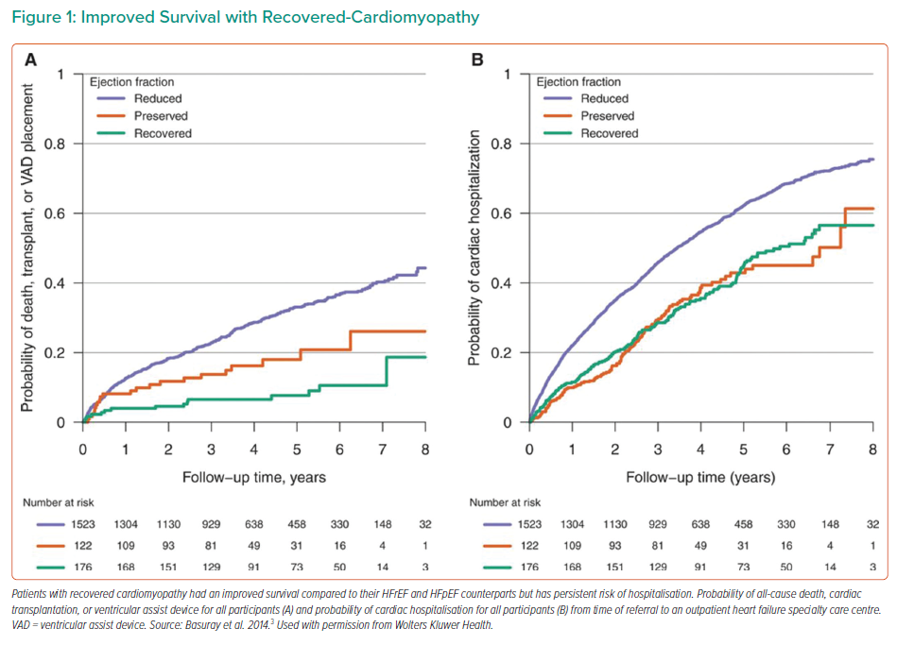
Wilcox J
Improved Survival with Recovered-Cardiomyopathy
Citation: Interventional Cardiology Review 2022;17(Suppl 1):29–30.
https://doi.org/10.15420/icr.2022.17.S1

