Slide 1
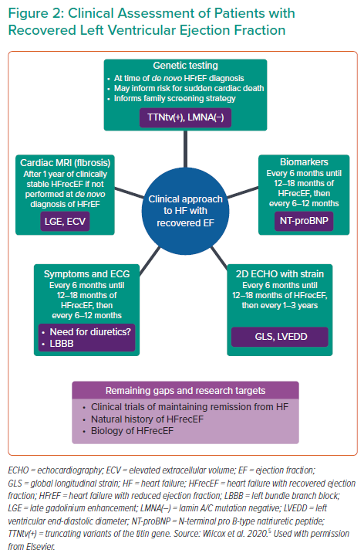
Wilcox J
Clinical Assessment of Patients with Recovered Left Ventricular Ejection Fraction
Citation: Interventional Cardiology Review 2022;17(Suppl 1):29–30.
https://doi.org/10.15420/icr.2022.17.S1

