Slide 1
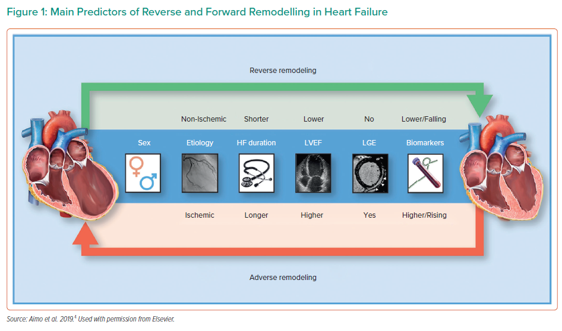
Kanwar M
Main Predictors of Reverse and Forward Remodelling in Heart Failure
Citation: Interventional Cardiology Review 2022;17(Suppl 1):31–2.
https://doi.org/10.15420/icr.2022.17.S1

