Slide 1
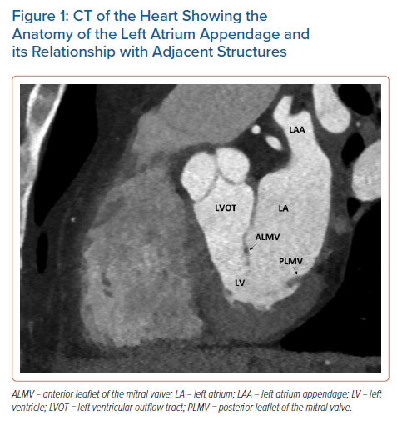
Dudzińska-Szczerba K, Kułakowski P, Michałowska I, Baran J
CT of the Heart Showing the Anatomy of the Left Atrium Appendage and its Relationship with Adjacent Structures
Citation: Arrhythmia & Electrophysiology Review 2022;11:e09.
https://doi.org/10.15420/aer.2022.08

