Slide 1
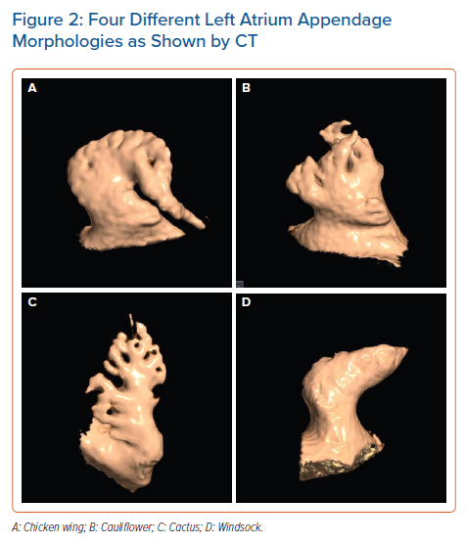
Dudzińska-Szczerba K, Kułakowski P, Michałowska I, Baran J
Four Different Left Atrium Appendage Morphologies as Shown by CT
Citation: Arrhythmia & Electrophysiology Review 2022;11:e09.
https://doi.org/10.15420/aer.2022.08

