Slide 1
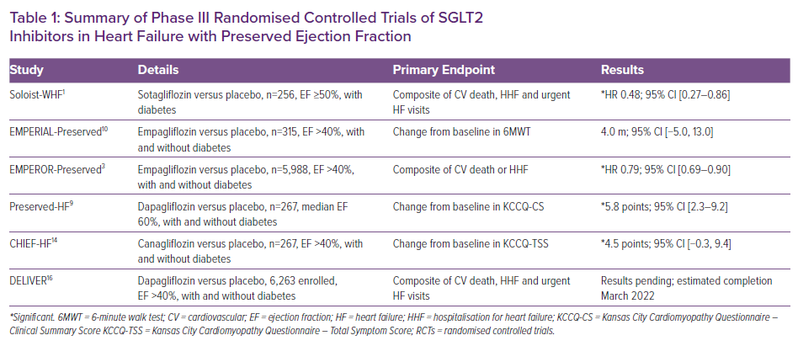
Deschaine B, Verma S, Rayatzadeh H
Summary of Phase III Randomised Controlled Trials of SGLT2 Inhibitors in Heart Failure with Preserved Ejection Fraction
Citation: Cardiac Failure Review 2022;8:e23.
https://doi.org/10.15420/cfr.2022.11

