Slide 1
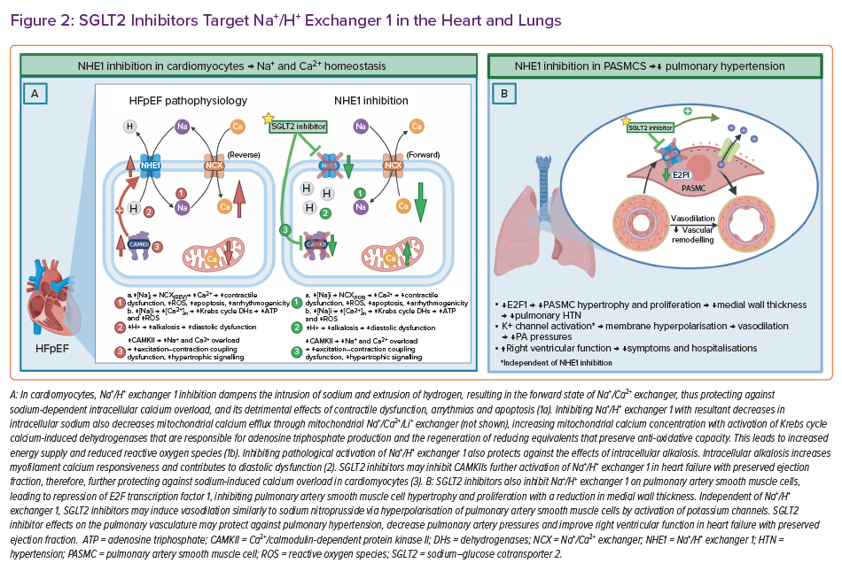
Deschaine B, Verma S, Rayatzadeh H
SGLT2 Inhibitors Target Na+ /H+ Exchanger 1 in the Heart and Lungs
Citation: Cardiac Failure Review 2022;8:e23.
https://doi.org/10.15420/cfr.2022.11

