Slide 1
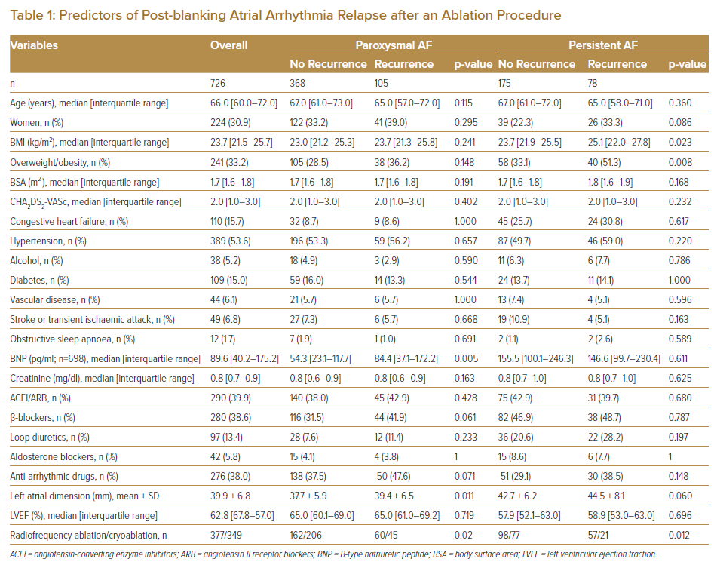
Takami A, Miake J, Kato M, Ogura K, Okamura A, Tomomori T, Tsujimoto D, Kawatani S, Kato M, Yamamoto K
Predictors of Post-blanking Atrial Arrhythmia Relapse after an Ablation Procedure
Citation: Journal of Asian Pacific Society of Cardiology 2022;1:e15.
https://doi.org/10.15420/japsc.2021.27

