Slide 1
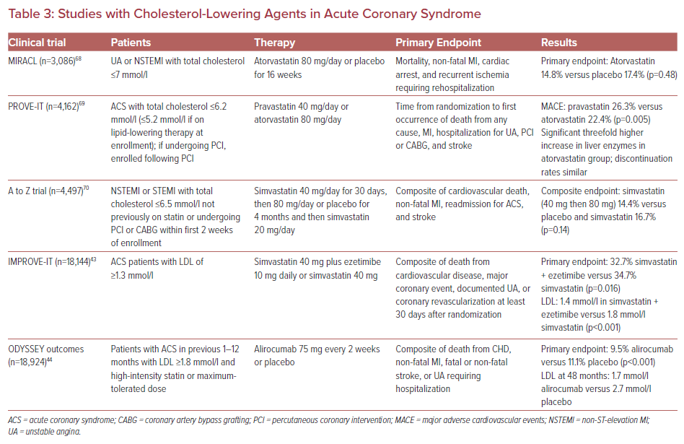
Barcelona R
Studies with Cholesterol-Lowering Agents in Acute Coronary Syndrome
Citation: US Cardiology Review 2022;16:e16.
https://doi.org/10.15420/usc.2022.05

