Slide 1

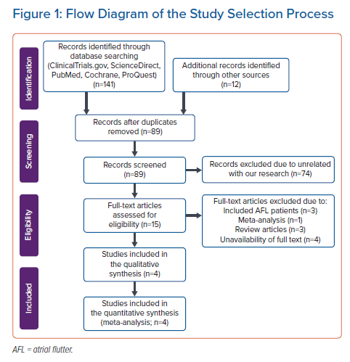
Waranugraha Y, Rizal A, Rohman MS, Tsai CT, Chiu FC
Flow Diagram of the Study Selection Process
Citation: Arrhythmia & Electrophysiology Review 2022;11:e10.
https://doi.org/10.15420/aer.2021.37

