Slide 1
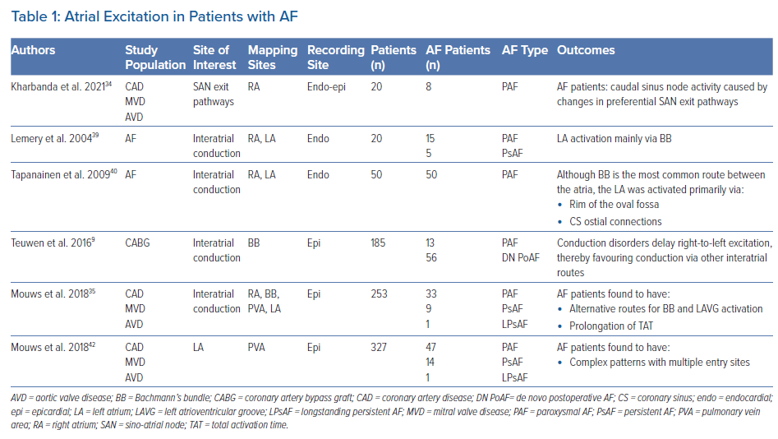
van Schie MS, de Groot NM
Atrial Excitation in Patients with AF
Citation: Arrhythmia & Electrophysiology Review 2022;11:e11.
https://doi.org/10.15420/aer.2022.03

