Slide 1
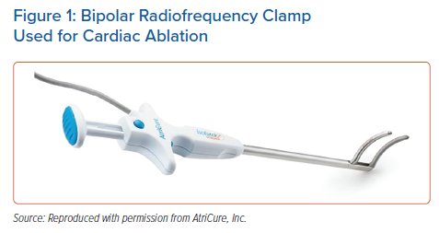
Kaba R, Ahmed O, Behr ER, Momin A
Bipolar Radiofrequency Clamp Used for Cardiac Ablation
Citation: Arrhythmia & Electrophysiology Review 2022;11:e12.
https://doi.org/10.15420/aer.2022.05

