Slide 1
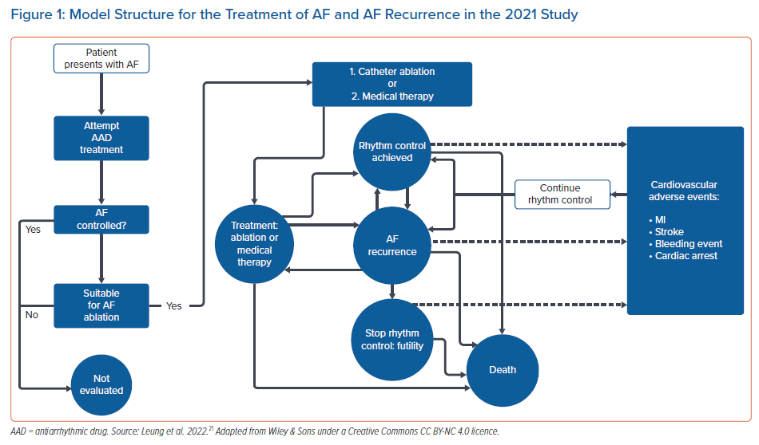
Leung LW, Akhtar Z, Kontogiannis C, Imhoff RJ, Taylor H, Gallagher MM
Model Structure for the Treatment of AF and AF Recurrence in the 2021 Study
Citation: Arrhythmia & Electrophysiology Review 2022;11:e13.
https://doi.org/10.15420/aer.2021.46

