Slide 1
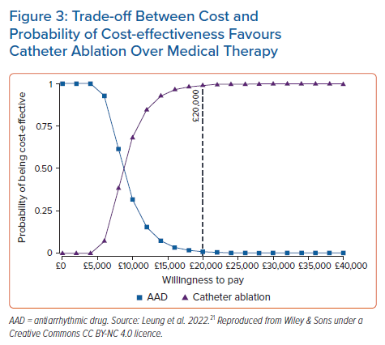
Leung LW, Akhtar Z, Kontogiannis C, Imhoff RJ, Taylor H, Gallagher MM
Trade-off Between Cost and Probability of Cost-effectiveness Favours Catheter Ablation Over Medical Therapy
Citation: Arrhythmia & Electrophysiology Review 2022;11:e13.
https://doi.org/10.15420/aer.2021.46

