Slide 1
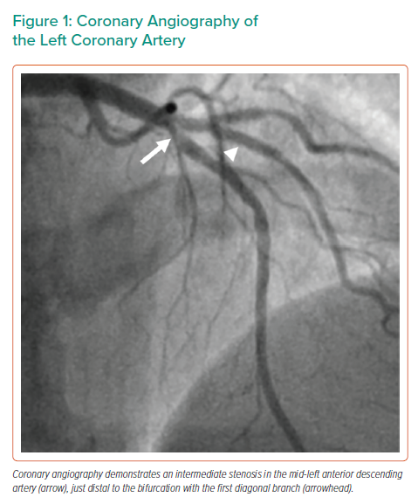
Volleberg R, van den Oord S, van Geuns RJ
Coronary Angiography of the Left Coronary Artery
Citation: Interventional Cardiology 2022;17:e08.
https://doi.org/10.15420/icr.2021.32

