Slide 1
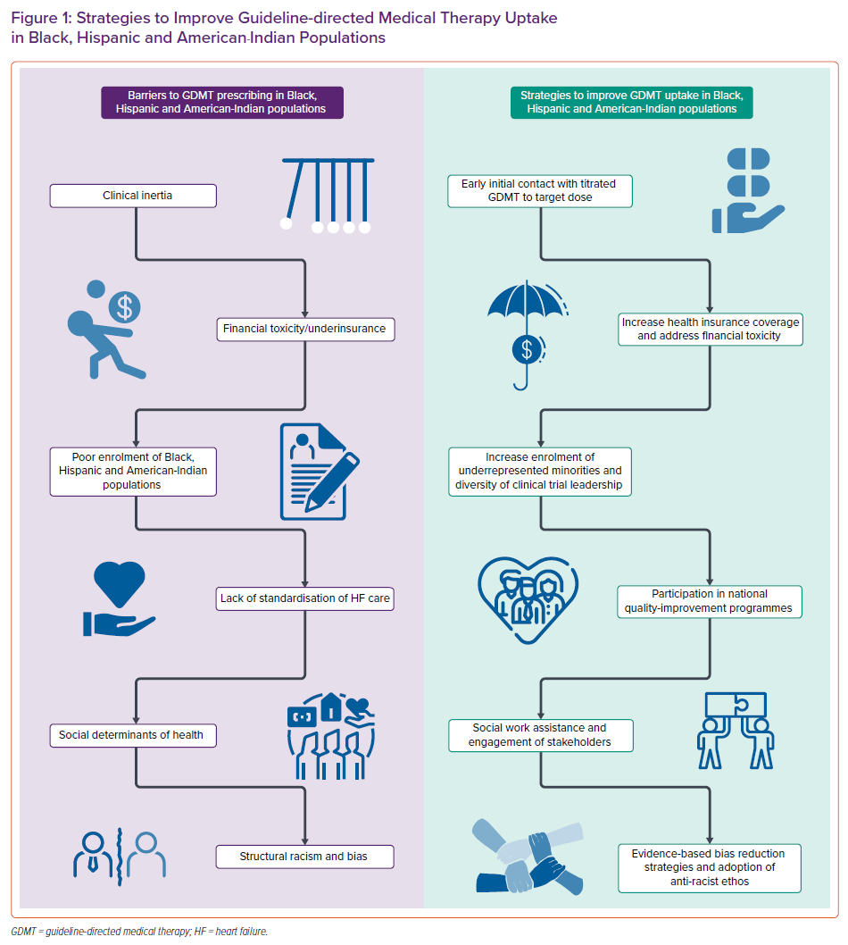
Ilonze O, Free K, Breathett K
Strategies to Improve Guideline-directed Medical Therapy Uptake in Black, Hispanic and American-Indian Populations
Citation: Cardiac Failure Review 2022;8:e25.
https://doi.org/10.15420/cfr.2022.02

