Slide 1
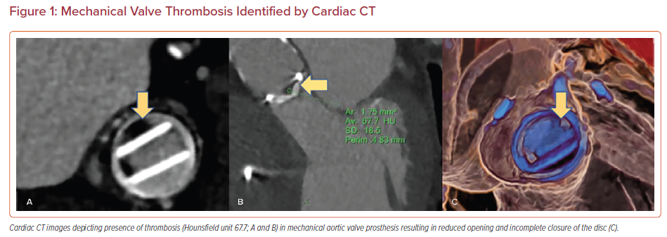
Pournazari P, Chang SM, Little SH, Goel S, Faza NN
Mechanical Valve Thrombosis Identified by Cardiac CT
Citation: US Cardiology Review 2022;16:e17.
https://doi.org/10.15420/usc.2021.19

