Slide 1
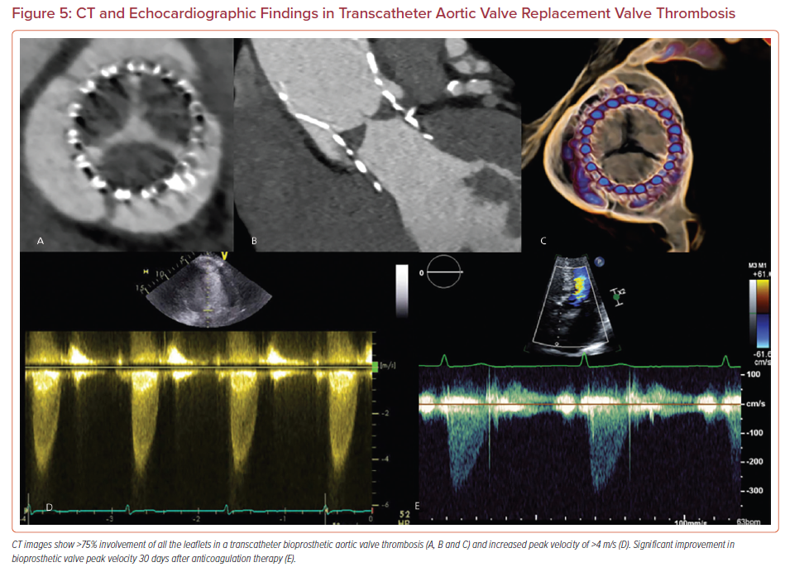
Pournazari P, Chang SM, Little SH, Goel S, Faza NN
CT and Echocardiographic Findings in Transcatheter Aortic Valve Replacement Valve Thrombosis
Citation: US Cardiology Review 2022;16:e17.
https://doi.org/10.15420/usc.2021.19

