Slide 1
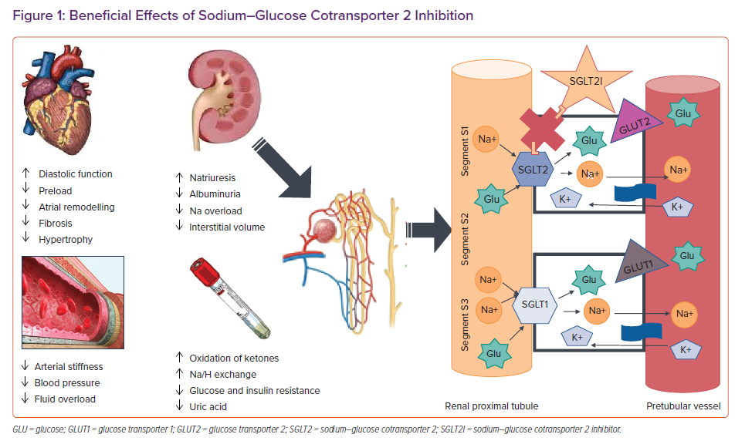
Gori M, D'Elia E, Sciatti E, Senni M
Beneficial Effects of Sodium–Glucose Cotransporter 2 Inhibition
Citation: Cardiac Failure Review 2022;8:e26.
https://doi.org/10.15420/cfr.2022.04

