Slide 1
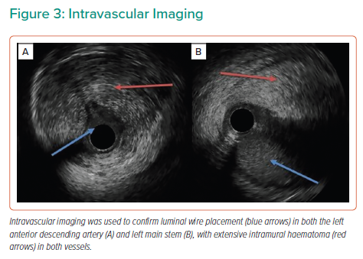
Mailey JA, Thompson P, Johnston PW, Owens C
Intravascular Imaging
Citation: Interventional Cardiology 2022;17:e09.
https://doi.org/10.15420/icr.2021.33

