Slide 1
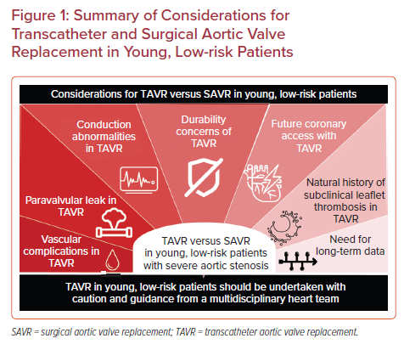
Nguyen Q, Luc JG, MacGillivray TE, Preventza OA
Summary of Considerations for Transcatheter and Surgical Aortic Valve Replacement in Young, Low-risk Patients
Citation: US Cardiology Review 2022;16:e18.
https://doi.org/10.15420/usc.2022.08

