Slide 1
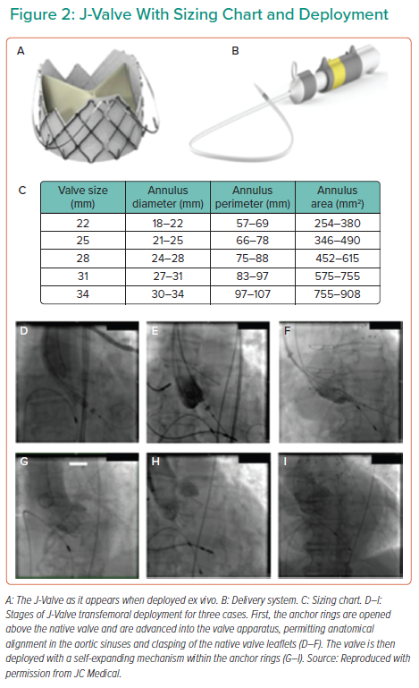
Costanzo P, Bamborough P, Peterson M, Deva DJ, Ong G, Fam N
J-Valve With Sizing Chart and Deployment
Citation: Interventional Cardiology 2022;17:e11.
https://doi.org/10.15420/icr.2021.19

