Slide 1
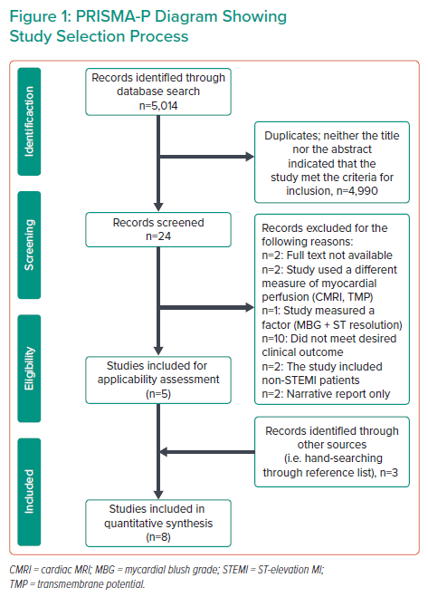
Cruz PV, Palmes P, Bacalangco N
PRISMA-P Diagram Showing Study Selection Process
Citation: Interventional Cardiology 2022;17:e10.
https://doi.org/10.15420/icr.2022.01

