Slide 1
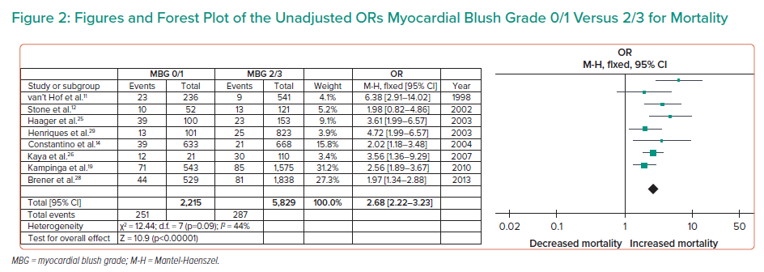
Cruz PV, Palmes P, Bacalangco N
Figures and Forest Plot of the Unadjusted ORs Myocardial Blush Grade 0/1 Versus 2/3 for Mortality
Citation: Interventional Cardiology 2022;17:e10.
https://doi.org/10.15420/icr.2022.01

