Slide 1
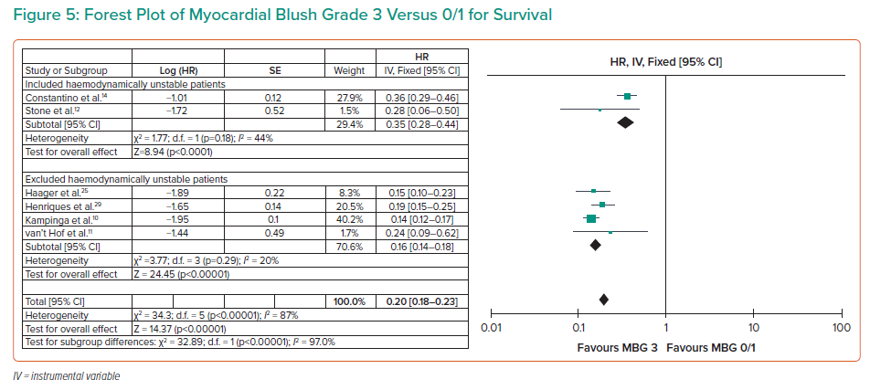
Cruz PV, Palmes P, Bacalangco N
Forest Plot of Myocardial Blush Grade 3 Versus 0/1 for Survival
Citation: Interventional Cardiology 2022;17:e10.
https://doi.org/10.15420/icr.2022.01

