Slide 1
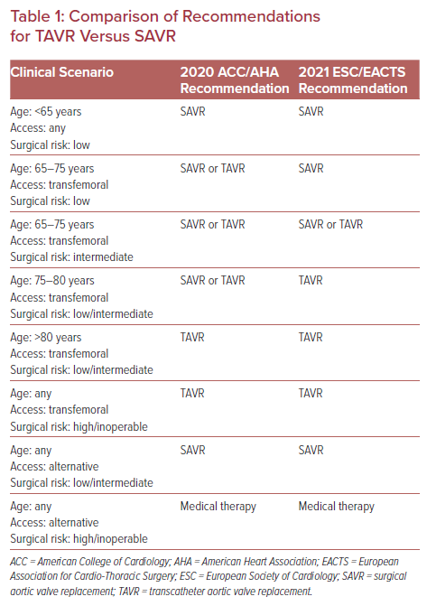
Khan S, Shi W, Kaneko T, Baron SJ
Comparison of Recommendations for TAVR Versus SAVR
Citation: US Cardiology Review 2022;16:e19.
https://doi.org/10.15420/usc.2022.04

