Slide 1
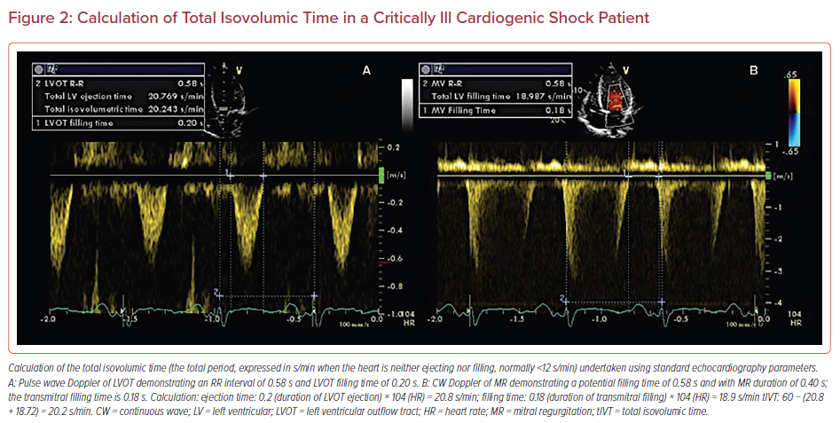
Uddin S, Anandanadesan R, Trimlett R, Price S
Calculation of Total Isovolumic Time in a Critically Ill Cardiogenic Shock Patient
Citation: US Cardiology Review 2022;16:e20.
https://doi.org/10.15420/usc.2021.23

