Slide 1
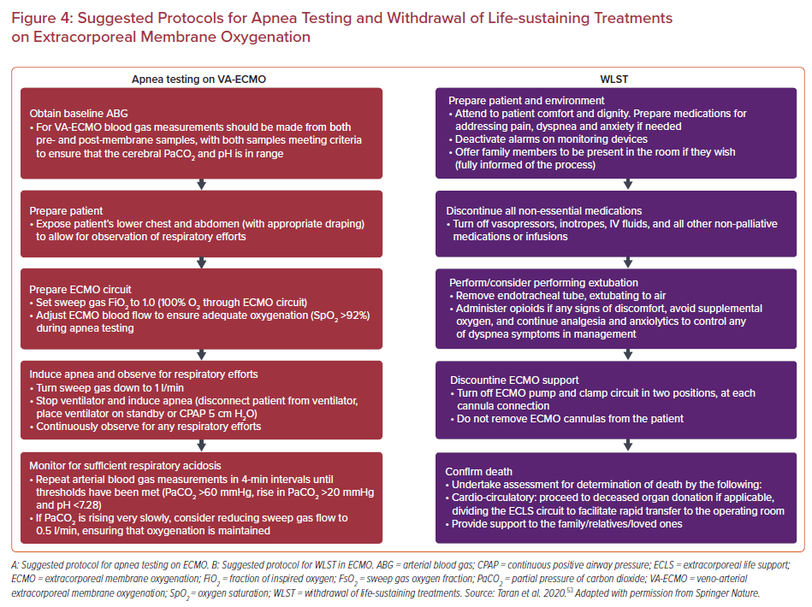
Uddin S, Anandanadesan R, Trimlett R, Price S
Suggested Protocols for Apnea Testing and Withdrawal of Life-sustaining Treatments on Extracorporeal Membrane Oxygenation
Citation: US Cardiology Review 2022;16:e20.
https://doi.org/10.15420/usc.2021.23

