Slide 1
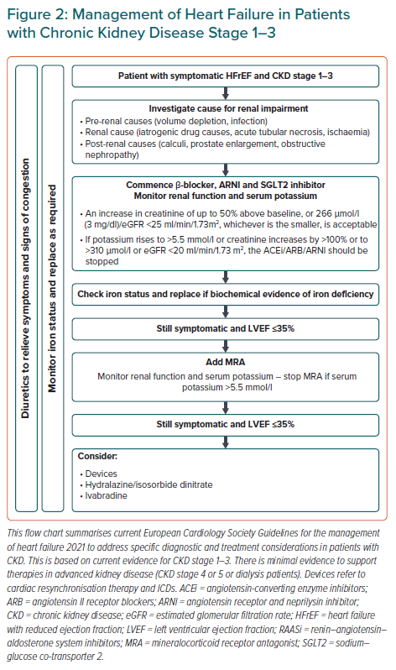
Ryan DK, Banerjee D, Jouhra F
Management of Heart Failure in Patients with Chronic Kidney Disease Stage 1–3
Citation: European Cardiology Review 2022;17:e17.
https://doi.org/10.15420/ecr.2021.33

