Slide 1

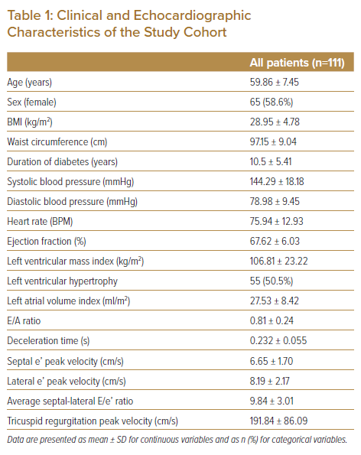
Foo DHP, Lam KH, Igo M, Sulaiman MNAB, Bujang MAB, Ku MY, King TL, Jong RHC, Ahip SS, Sahiran MF, Mustapha M, Michael J, Abdullah A, Fong AYY
Clinical and Echocardiographic Characteristics of the Study Cohort
Citation: Journal of Asian Pacific Society of Cardiology 2022;1:e16.
https://doi.org/10.15420/japsc.2021.25

