Slide 1
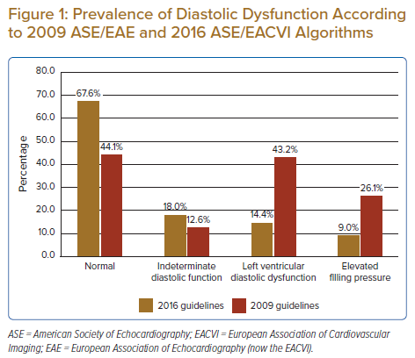
Foo DHP, Lam KH, Igo M, Sulaiman MNAB, Bujang MAB, Ku MY, King TL, Jong RHC, Ahip SS, Sahiran MF, Mustapha M, Michael J, Abdullah A, Fong AYY
Prevalence of Diastolic Dysfunction According to 2009 ASE/EAE and 2016 ASE/EACVI Algorithms
Citation: Journal of Asian Pacific Society of Cardiology 2022;1:e16.
https://doi.org/10.15420/japsc.2021.25

