Slide 1
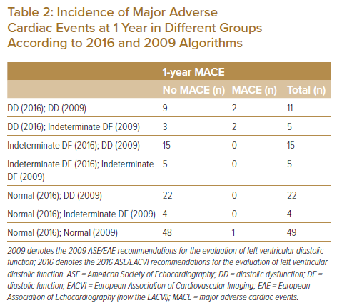
Foo DHP, Lam KH, Igo M, Sulaiman MNAB, Bujang MAB, Ku MY, King TL, Jong RHC, Ahip SS, Sahiran MF, Mustapha M, Michael J, Abdullah A, Fong AYY
Incidence of Major Adverse Cardiac Events at 1 Year in Different Groups According to 2016 and 2009 Algorithms
Citation: Journal of Asian Pacific Society of Cardiology 2022;1:e16.
https://doi.org/10.15420/japsc.2021.25

