Slide 1
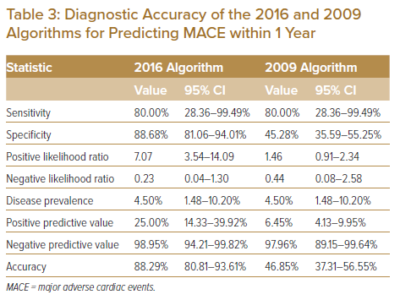
Foo DHP, Lam KH, Igo M, Sulaiman MNAB, Bujang MAB, Ku MY, King TL, Jong RHC, Ahip SS, Sahiran MF, Mustapha M, Michael J, Abdullah A, Fong AYY
Diagnostic Accuracy of the 2016 and 2009 Algorithms for Predicting MACE within 1 Year
Citation: Journal of Asian Pacific Society of Cardiology 2022;1:e16.
https://doi.org/10.15420/japsc.2021.25

