Slide 1
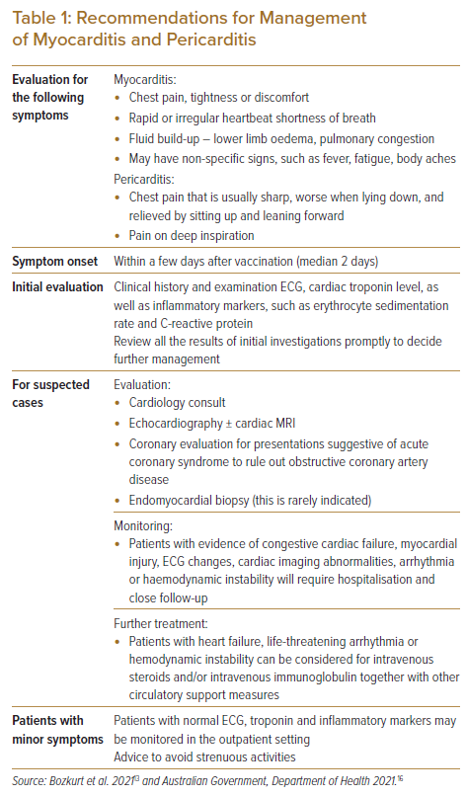
Hong R, Yap JJL, Yeo KK
Recommendations for Management of Myocarditis and Pericarditis
Citation: Journal of Asian Pacific Society of Cardiology 2022;1:e17.
https://doi.org/10.15420/japsc.2021.26

