Slide 1
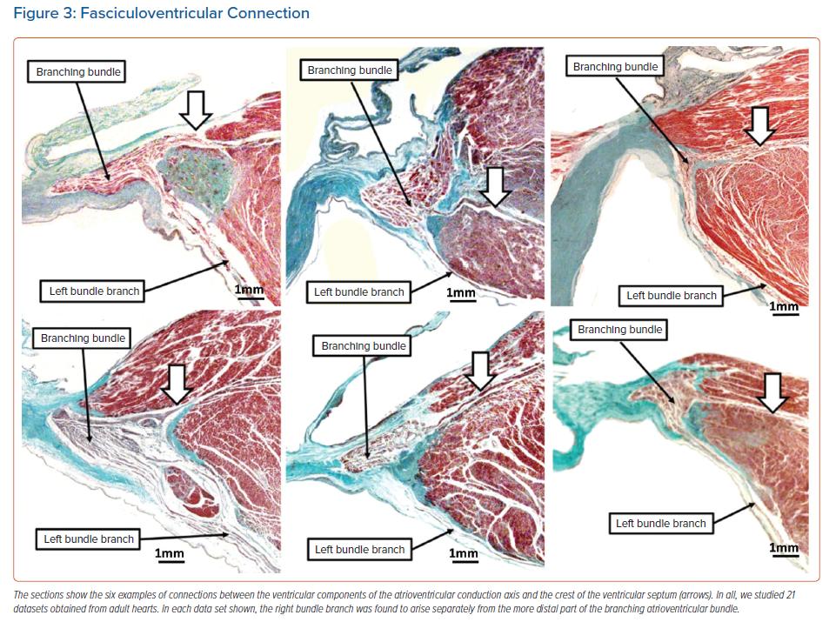
Back Sternick E, Sánchez-Quintana D, Wellens HJ, Anderson RH
Fasciculoventricular Connection
Citation: Arrhythmia & Electrophysiology Review 2022;11:e14.
https://doi.org/10.15420/aer.2022.12

