Slide 1
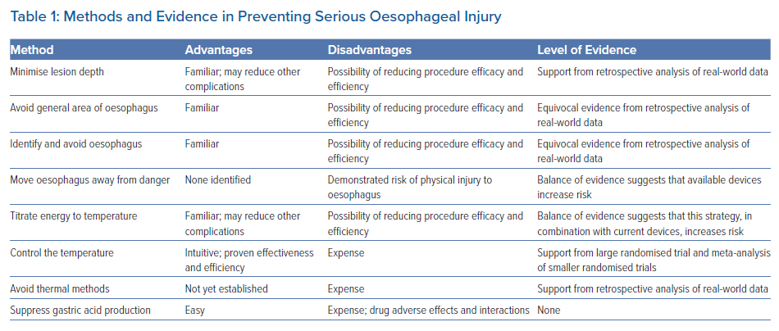
Leung LW, Akhtar Z, Hayat J, Gallagher MM
Methods and Evidence in Preventing Serious Oesophageal Injury
Citation: Arrhythmia & Electrophysiology Review 2022;11:e15.
https://doi.org/10.15420/aer.2021.67

