Slide 1
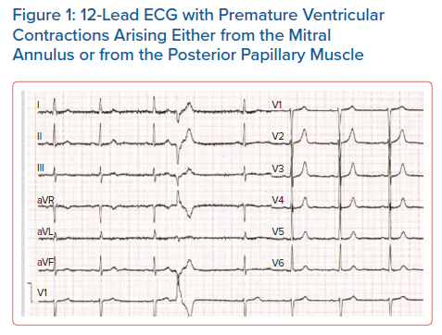
Korovesis TG, Koutrolou-Sotiropoulou P, Katritsis DG
12-Lead ECG with Premature Ventricular Contractions Arising Either from the Mitral Annulus or from the Posterior Papillary Muscle
Citation: Arrhythmia & Electrophysiology Review 2022;11:e16.
https://doi.org/10.15420/aer.2021.28

