Slide 1
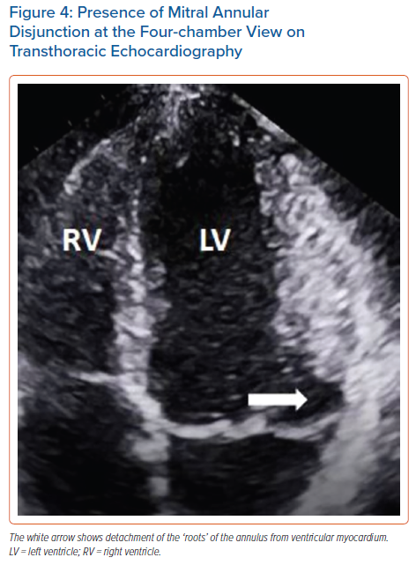
Korovesis TG, Koutrolou-Sotiropoulou P, Katritsis DG
Presence of Mitral Annular Disjunction at the Four-chamber View on Transthoracic Echocardiography
Citation: Arrhythmia & Electrophysiology Review 2022;11:e16.
https://doi.org/10.15420/aer.2021.28

