Slide 1
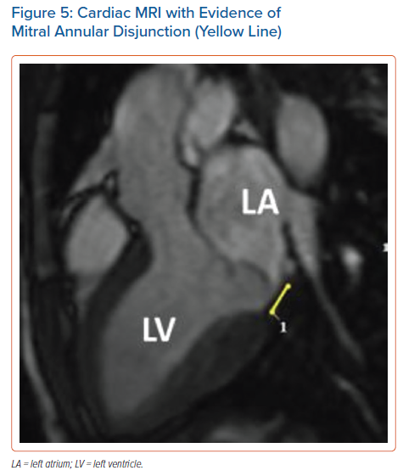
Korovesis TG, Koutrolou-Sotiropoulou P, Katritsis DG
Cardiac MRI with Evidence of Mitral Annular Disjunction (Yellow Line)
Citation: Arrhythmia & Electrophysiology Review 2022;11:e16.
https://doi.org/10.15420/aer.2021.28

