Slide 1
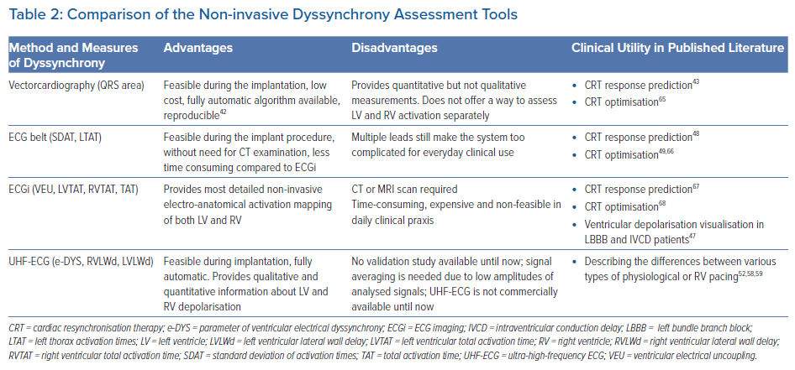
Mizner J, Jurak P, Linkova H, Smisek R, Curila K
Comparison of the Non-invasive Dyssynchrony Assessment Tools
Citation: Arrhythmia & Electrophysiology Review 2022;11:e17.
https://doi.org/10.15420/aer.2022.01

