Slide 1
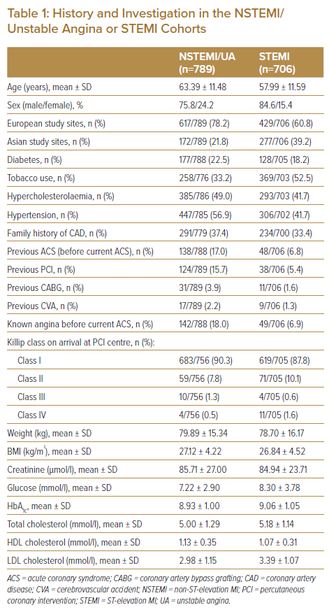
Wan Ahmad WA, Benit E, Legrand VM, Yahya AF, Cheem Tan H, Rifqi S, Abdul Kader MAS, Pironi B, de Winter RJ, Tam CCF, Ligtenberg E, DeLuca G, Suryapranata H
History and Investigation in the NSTEMI/ Unstable Angina or STEMI Cohorts
Citation: Journal of Asian Pacific Society of Cardiology 2022;1:e18.
https://doi.org/10.15420/japsc.2021.29

